Slide 1
The Lens of Data:
A Brief & Personal History of LGBT+ Parenting Research - Fiona Tasker email: f.tasker@bbk.ac.uk

Slide 2
LGBTQ+ Parenting Research: 1980s To Now and the Lens of Data
Reviews have identified 3 waves of research on same sex parenting (e.g. Golombok, 2007; Johnson, 2012 ) waves coincide (greater or lesser extent) in different societies
Johnson’s 2012 3 Waves of research on lesbian mothers:
1st wave: lesbians who had become parents while in heterosexual relationships (family & child outcome comparisons with heterosexual families)
2nd wave: examined women who became parents in the context of a lesbian identity (family & child outcome comparisons with heterosexual families)
3rd wave: unique challenges faced by lesbian mothers (how to manage sexual minority stress). For example: Decisions about donor conception or whose sperm to use; the challenge of coping with stigma
I propose a 4th wave: allowing family members to self-define (queering of parenting and an increase interest in bisexual, trans and gender (nonconforming) diversity in parenting)

Slide 3
1st wave: lesbians (gay men) became parents in heterosexual relationships
2nd wave: lesbians (gay men) who then planned children
3rd wave: examining unique challenges
New proposed 4th wave: self-defining LGBTQ+ parented families
The Underwave off Kanagawa Hokusai 1829/1833 Rijksmuseum

Slide 4
The First Wave Post-heterosexual Relationship Dissolution (PHR)
Lesbians (gay men) who became parents in heterosexual relationships (family & child outcome comparisons)
Lesbian Mothers
Golombok et al. (1983)
Gasker & Golombok (1997)
Gay Fathers
Barrett & Tasker (2001)
Transgender parents
Freedman, Tasker & Di Ceglie (2002)
Reviews:
Tasker (2013)
Tasker & Rensten (2019)
Tasker & Lavender-Stott (2020 in press)

Slide 5
May be a dwindling number in countries with established equal rights legislation … but still the pain of coming out
Phillip Schofield:
Support for ITV presenter after he comes out as gay
https://www.bbc.co.uk/news/entertainment-arts-51414010

Slide 6
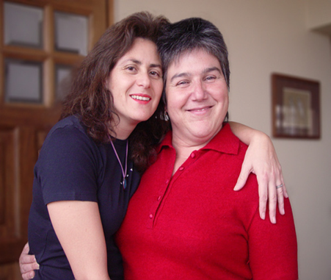
Simultaneous Waves Of LGB-parenting Research
Victor Figueroa Guinez’s Chilean studies of lesbian motherhood
(Figueroa Guinez, 2018 Birkbeck PhD thesis)
Study (Wave) 1 Narrative identities lesbian motherhood PHR
Study (Wave) 2 Parenting desires and intentions among Chilean young lesbian and bisexual women.
Study (Wave) 3 experiential variation within studies 1 & 2
Chile (March 2012) Karen Atala custody award
Inter-American Court of Human Rights

Slide 7
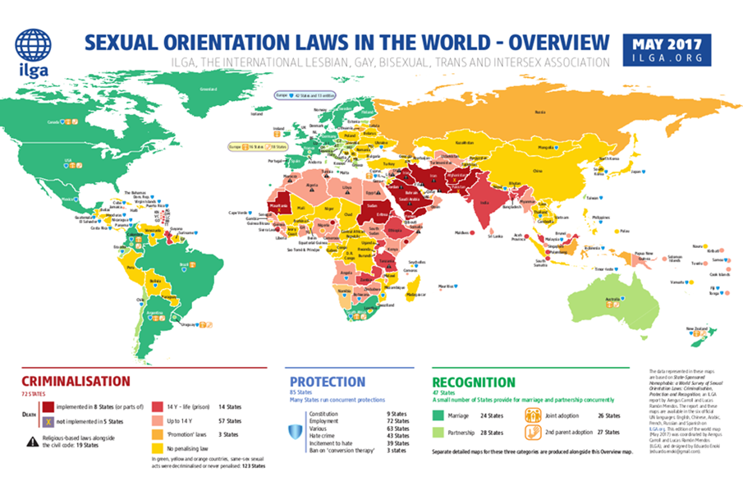
Sociohistorical context: Exploring cultural variations in attitudes to same-gender parenting
Victor Figueroa Guinez, Jorge Gato, Martin Tusl, Vanessa Lerne, Geva Shenkman & Fiona Tasker: Cross-cultural data on attitudes (responses to the same vignette (with central characters being either lesbian, gay or heterosexual parents from students in Brazil, Chile, UK, Portugal, Czech Republic, Israel)
e.g. Tušl, Gato, Tasker & Figueroa (2020 in press)

Slide 8
The Second Wave: Planned Same-sex Couple Families
Lesbians (gay men) becoming parents after coming out as lesbian or gay (family & child outcome comparisons)
Children in fatherless families study (LM via DI)
Golombok, Tasker & Murray (1997)
Tasker & Golombok (1998)
Children adopted by LG or Heterosexual parents
Golombok et al. (2014)
Children of surrogacy arranged by GF
Shenkman, Siboni, Tasker & Costa (2020 in press).

Slide 9
Third Wave Unique Challenges: How to manage sexual minority stress & the decisions heterosexual people don’t have to make

Slide 10
Empowering Adoptive Families (EAF) Survey UK & EAF Family Mapping Pedro A. Costa, Isabel Leal & Fiona Tasker
Total N=253 UK adoptive parents completed online EAF survey
N=39 gay or bisexual fathers
N=36 lesbian or bisexual mothers
N=71 heterosexual parents
Funding from Fundação para a Ciência e Tecnologia
(Portugal) & British Academy & Leverhulme Foundation (UK)

Slide 11
Were “harder-to-place” children placed with LGB parents? EAF Survey UK Data
Were “harder-to-place” children placed with LGB parents?
Not at the back of the queue
No differences in adoption approval time
No differences children’s previous institutional or foster care placements
No differences children’s pre-adoption problems
More likely to choose or feel able to adopt children who are harder to place
Child’s demographic characteristics
more likely to adopt boys G > L / H
more likely adopt an older child G > L / H
more likely adopt child from BAME group L > G /H
more likely adopt a child with a physical disability L/H >G

Slide 12
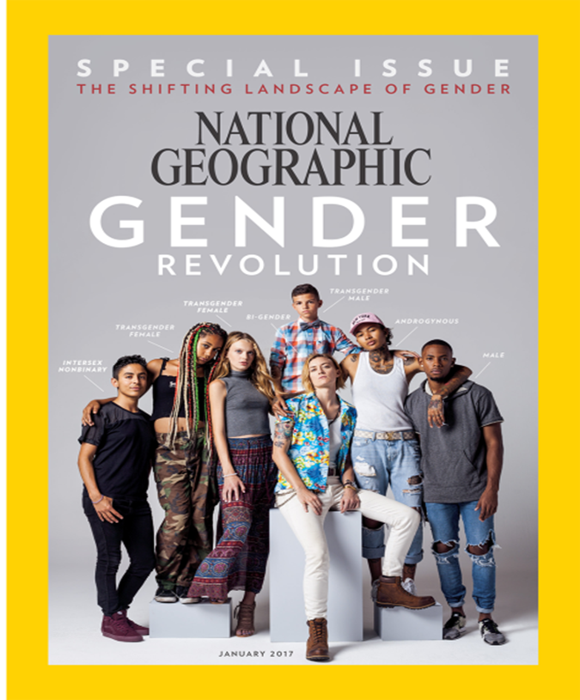
The 4th Wave: Self-Defining Families or the advent of Queering and gender minority parenting?

Slide 13
4th Wave: Self-Defining Families not being defined by any one category LGBTQ+ History: Taking Stock
Writing an historical chapter (Tasker, 2013) and taking stock at 50: the problem with data quantitative categories not representing fluidity
Appeal of everyday qualitative data not just performative or queer but there’s always the problem of one standing for many
"One from All" by Lihoman... is licensed under CC BY 2.0
https://search.creativecommons.org/photos/2555ae89-4066-4bfb-922b-a5d97ddec782

Slide 14
Qualitative data and self-definition
If allowing participants to self-define then need to employ data procedures that go beyond simply collecting consent
Standard: collect consent before interview, debrief, allow participants to withdraw if they elect to do so
+ community consultant(s) to help frame research & interview questions
+ sharing main questions with participants in advance & following idiographic narrative life story approach
verbal representation data [transcript]
visual representation data [family map]
+ pseudonymized transcript / family map checking window
+ participant(s) overview of report – sharing paper

Slide 15
Love data: representation of group or issue not the individual
Tension between individual level and group level data
e.g. different family members different perspectives
e.g. setting up of ground rules for focus group data
Tension between researcher control and individual control: ultimately for research it’s about representing data not about representing the individual but being mindful of participant’s welfare

Slide 16
Bisexual Mothers Project: Non-binary sexuality and parenting
Marie Delvoye & Fiona Tasker
Funding from Leonardo da Vinci (EU) training placement
Tasker & Delvoye (2015) – thematic narrative analysis
Delvoye & Tasker (2016) – life course narrative analysis
Tasker & Delvoye (2018) – family map narrative analysis

Slide 17
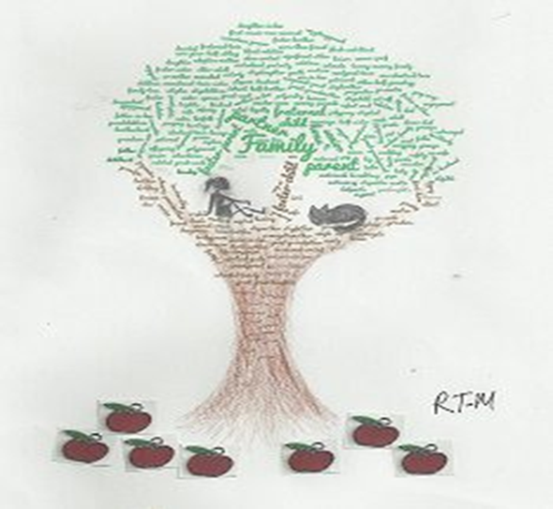
Bisexual Mothers:Family Map Thematic Analysis https://familymappingexercises.wordpress.com see Tasker Malley & Costa (in press)
Family Core: Caring connections and the ongoing parenting of grown up offspring
Thinking within and beyond heteronormative boundaries: a challenge to include new partners in family networks
Traditional extended family relatives included because they are good enough to be counted upon and share a common allegiance
Ex-partners mostly warranting inclusion as the children’s other parent
Affirming bisexuality through choosing family

Slide 18
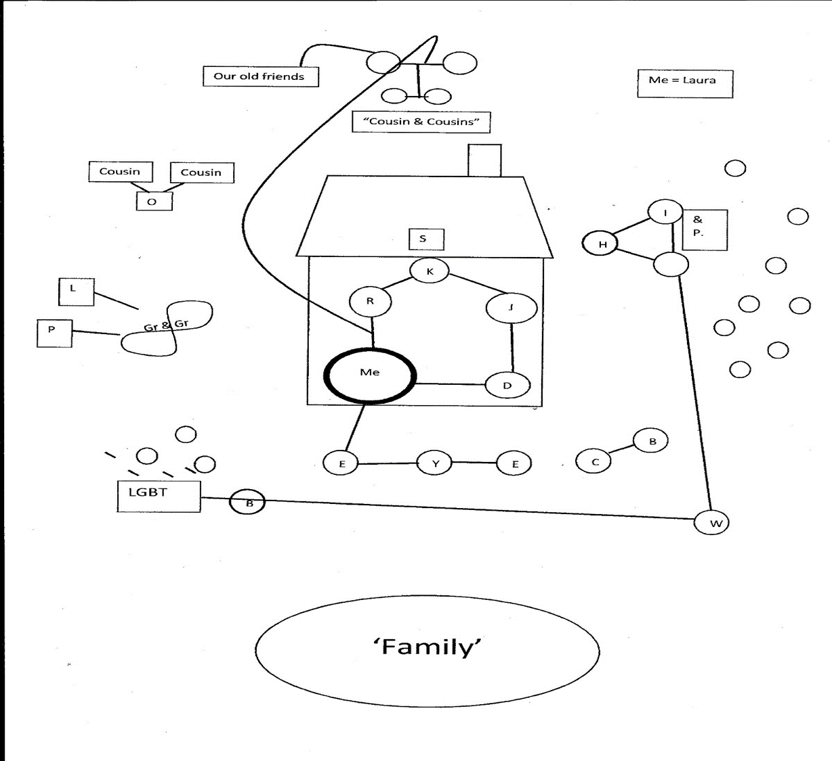
Bisexual Mothers Project: Laura’s Family Map

Slide 19
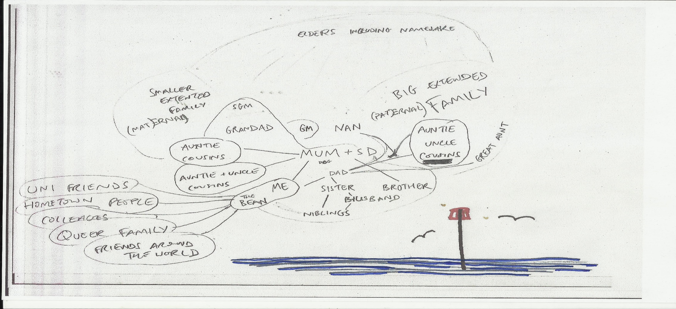
Where to next? Trans men’s future families: Carrying babies

Slide 20
Where to next? For LGBTQ people & their families
Families are about more than kinship ties
Family can enable and cherish but also coercively constrain
Families have fluidity of form from individual life cycles of their members, the aspirations of members and the entry /exit of members
LGBTQ people pushing back the boundaries of family but we eagerly await other new frontiers of family in the future.

Slide 21
References:
Barrett, H & Tasker, F. (2001) Growing up with a gay parent: Views of 101 gay fathers on their sons’ and daughters experiences. Educational and Child Psychology, 18, 62-77.
Delvoye, M. & Tasker, F. (2016). Narrating Self-Identity in Bisexual Motherhood. Journal of GLBT Family Studies, 12, 5-23, DOI: 10.1080/1550428X.2015.1038675
Freedman, D. Tasker, F. & Di Ceglie, D. (2002) Children and Adolescents with Transsexual Parents Referred to a Specialist Gender Identity Development Service: A Brief Report of Key Developmental Features. Clinical Child Psychology & Psychiatry, 7, 423-432.
Figueroa Guinez (2018). Lesbian Motherhood in a Chilean Cultural Context. Birkbeck: PhD thesis.
Golombok, S. (2007) Foreword Journal of GLBT Family Studies, 3:2-3, xxi-xxvii, DOI: 10.1300/J461v03n02_a
Golombok, S., Mellish, L., Jennings, S., Casey, P., Tasker, F. & Lamb, M. (2014). Adoptive gay father families: Parent-child relationships and children's psychological adjustment. Child Development, 85(2), 456-68. DOI: 10.1111/cdev.12155
Golomobok, S., Tasker, F. & Murray, C. (1997) Children raised in fatherless families from infancy: Family relationships and the socioemotional development of children of lesbian and single heterosexual mothers. Journal of Child Psychology & Psychiatry, 38, 783-791.
Johnson, S. (2012). Lesbian Mothers and Their Children: The Third Wave. J Lesbian Studies, 16, 45- 53. DOI: 10.1080/10894160.2011.557642

Slide 22
References:
Shenkman, G., Siboni, O., Tasker, F. & Costa, P.A. (2020 in press). Pathways to Fatherhood: Psychological Well-Being Among Israeli Gay Fathers Through Surrogacy, Gay Fathers Through Previous Heterosexual Relationships, and Heterosexual Fathers. Frontiers in Psychology, section Gender, Sex and Sexualities.
Tasker, F. (2013). Lesbian and gay parenting post-heterosexual divorce and separation. In A.E. Goldberg & K.R. Allen (Eds.) “LGBT Parented Families: Possibilities for New Research and Implications for Practice” (pp.3-20). New York: Springer. ISBN 978-1-4614-4556-2 (ebook) DOI 10.1007/978-1-4614-4556-2
Tasker, F. & Bigner, J.J. (2007). Gay & lesbian parenting: New Directions. New York: Routledge.
Tasker, F. & Delvoye, M. (2018). Maps of family relationships drawn by women engaged in bisexual motherhood: Defining family membership. Journal of Family Issues, 39, 4248-4274. Doi: 10.1177/0192513X18810958
Tasker, F. & Delvoye, M. (2015). Moving out of the shadows: Accomplishing Bisexual Motherhood. Sex Roles, 73, 125–140. DOI 10.1007/s11199-015-0503-z
Tasker, F. L. & Golombok, S. (1997).Growing up in a lesbian family: Effects on child development. New York: Guilford Press.
Tasker, F. & Golombok, S. (1998) The role of co-mothers in planned lesbian-led families. Journal of lesbian Studies, 2, 49-68.

Slide 23
Third Wave: Unique Challenges: How to manage sexual minority stress & the decisions heterosexual people don’t have to make
Tasker, F. & Granville, J. (2011) Children’s views of family relationships in lesbian-led families. Journal of GLBT Family Studies, 7, 182-199. (selected for lead paper in New Directions in the Field). NB English version of Tasker & Granville “Die Perspektive des Kindes in Lesbischen Familien.”
Tasker, F. & Lavender-Stott, E. S. (2019 in press). LGBTQ Parenting Post Heterosexual Relationship Dissolution. In Goldberg, A. E. & Allen, K.R. (Eds.) LGBTQ-Parent Families: Innovations in Research & Implications for Practice 2ed. New York: Springer.
Tasker, F., Malley, M. & Costa, P.A. (in press). Family Mapping Exercises (FMEs) for Adults and Children in LGBTQ-Parented Families. Chapter for consideration for Whitman, J. & Boyd, C. (Eds.) new edition of “The Therapist’s Notebook for Sexual and Gender Identity Diverse Clients: Homework, Handouts, and Activities for Use in Counseling, Training, and Psychotherapy.” Harrington Park Press.
Tasker, F. & Rensten, K. (in press). Social Science Research on Heterosexual Relationship Dissolution and Divorce Where One Parent Comes Out as LGB. In A. E. Goldberg & A. Romero (Eds.) LGBTQ Divorce and Relationship Dissolution: Psychological and Legal Perspectives and Implications for Practice. Oxford, UK: Oxford University Press.
Tušl, M, Gato, J., Tasker, F. & Figueroa, V. (2019 in press). Czech psychology students‘ attitudes towards same-sex parenting, Psychology & Sexuality, DOI: 10.1080/19419899.2019.1674365

